Slide 1
COMO GARANTIR APRENDIZAGEM E PESQUISA ININTERRUPTAS POR MEIO DA RUCKUS
Alisson Carvalho Freire
Ruckus Systems Engineer
Notes:
Quando analisamos o mercado de educação, há uma tendência muito grande para que o currículo se torne digital, melhorando a experiência de todos os envolvidos, tanto professores, quanto alunos.

Slide 2
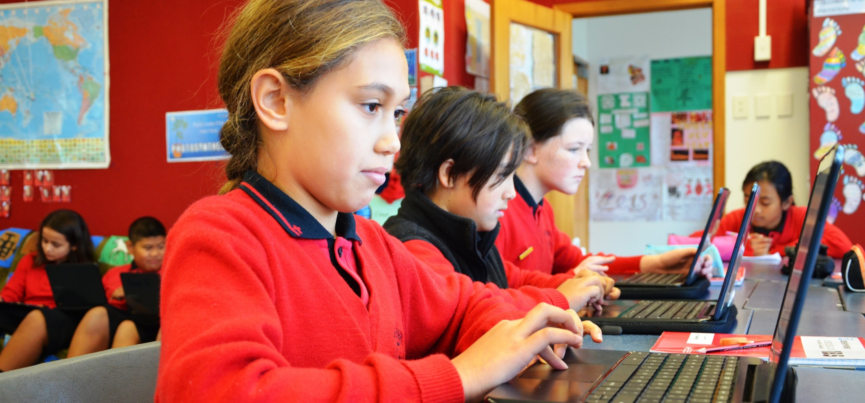

Crescimento de Vídeo
Em torno de 50% do currículo será digital dentro de 3 anos
Notes:
Video will represent 80%+ of network traffic by 2021
There will be 1.9 billion Internet video users by 2021
- They will be watching 3 trillion minutes of video per month.
Even with only 10% digital curriculum today, IT is being stretched thin to support campus technology.
It’s no surprise more schools are turning to managed services.

Slide 3





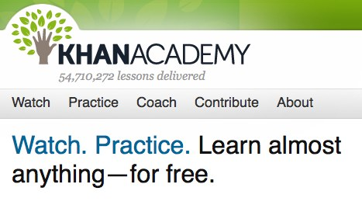

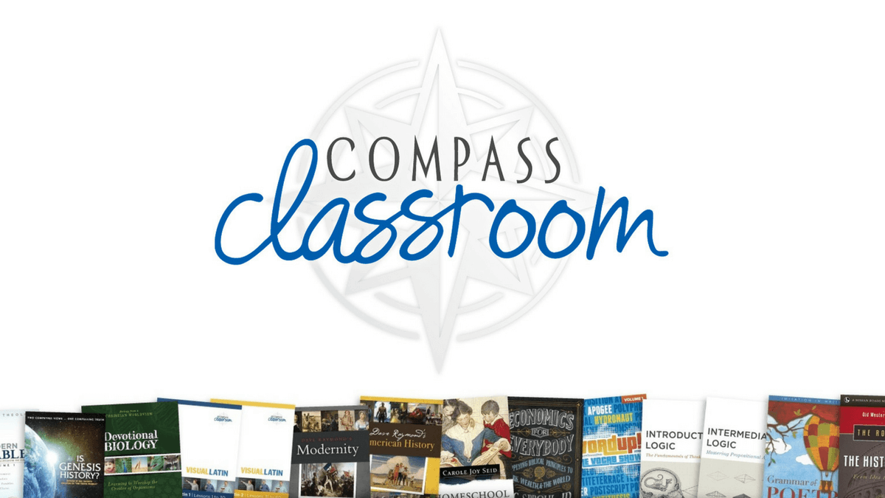



Valor do Vídeo
Vídeos auxiliam no aprendizado do conteúdo, conhecido como “processamento cognitivo”
A instrução baseada em vídeo oferece suporte a alunos que, de outra forma, dependem de entrega assíncrona
Vídeos fornecem feedback contínuo para dominar uma tarefa, muito superior ao texto ou gráficos
Notes:
Video is taking over as the most commonly shared and accessed type of media on the Internet. I bet some of you are sharing the latest cat video right now.
There’s a ton of curated video curricula from any number of sources including both from traditional publishers as well as traditional broadcasters.
There’s also the competition from independent sources like teachers, subject matter experts, and foundation funded programs.
There is no shortage of content and it grows daily.

Slide 4
Ruckus Entrega uma Experiência Superior para Ambientes de Alta Densidade (Exemplo: Vídeo)
Somente a Ruckus foi capaz de entregar 60 dos 60 fluxos de vídeo durante a carga de dados
Nota: 60 clientes de vídeo (Chromebooks) e 2 clientes de dados (Mac Minis) foram usados no teste
Fonte: Divergent Dynamics
Notes:
In a recent performance benchmark tests validated by Divergent Dynamics, a mid range Ruckus 802.11 ac Wave 2 AP was tested against similar competitive products on how well it delivered video streams in a high density situation. In this case, we had 60 video clients streaming video and 2 data clients running data. The test took place in a real-world environment – two adjacent classrooms in middle school. A single AP was placed by the shared wall to provided coverage for both rooms.
We looked specifically at video traffic because it dominates data traffic volume in many of today’s networks. In addition to high bandwidth consumption, video is distinguished by its effect on end user quality of experience or QoE. Poor video QoE , indicated by stalling, is highly disruptive to the end user.
This graph shows the number of stall-free video streams before load and after the data clients began downloading. Most of APs, except Ruckus and Aruba, were NOT able to support all 60 clients, even without load. Once the data load was initiated, only the Ruckus AP was able to successfully deliver all 60 videos stall free.

Slide 5
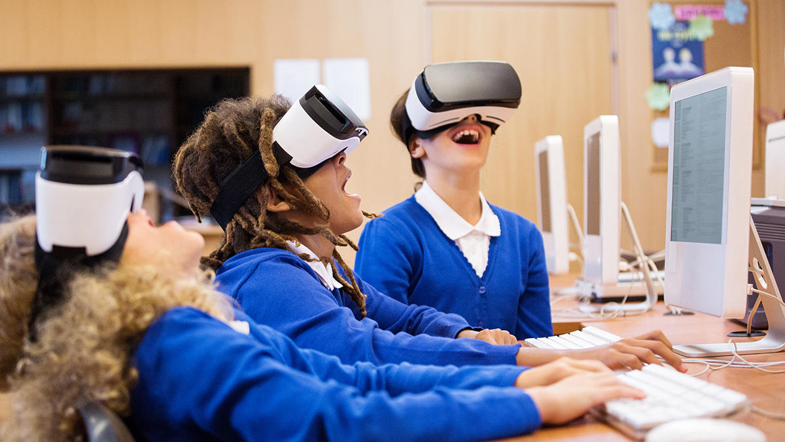
O que Realidade Virtual pode fazer?
94% acreditam RV beneficiará a sala de aula
97% acham que RV foi feita para obter mais alunos engajados
66% acreditam que RV pode tornar o mundo mais fácil de relatar
68% acreditam que RV ajudará os alunos a superarem barreiras financeiras ou físicas para experimentar
Notes:
Lenovo surveyed 500 teachers in the UK
94% think VR will benefit the classroom
While only 23% had used VR in the classroom, 97% of those that used it found it made for more engaged students
36% struggle to make things in the real world relatable when students have not experienced them, 42% said they don’t have time to do that --- 66% believed that these problems can be solved through VR.
68% believed VR will help students overcome financial or physical barriers to experience

Slide 6
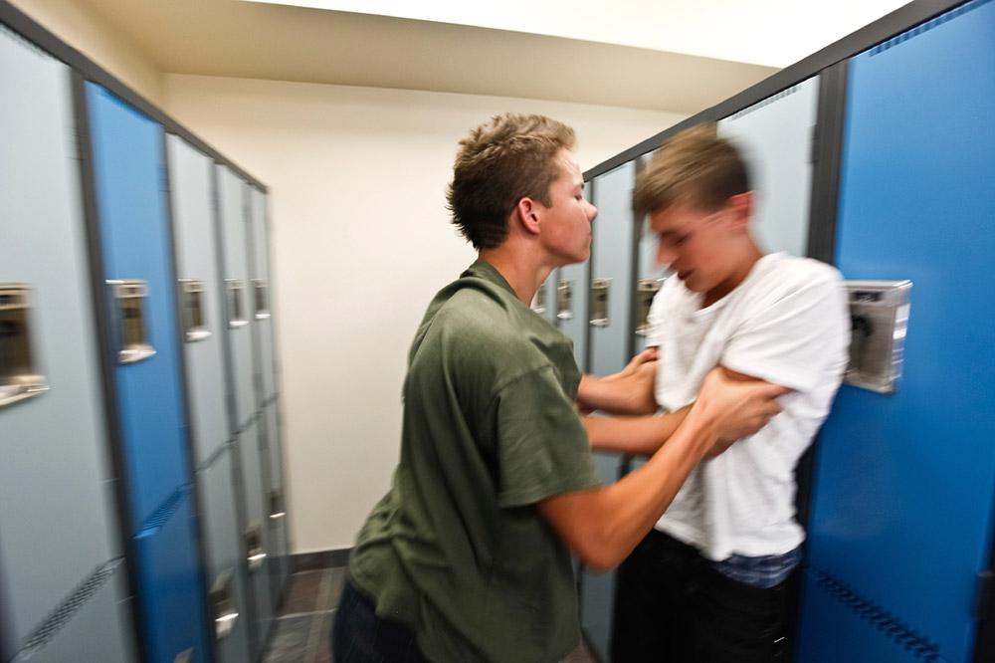

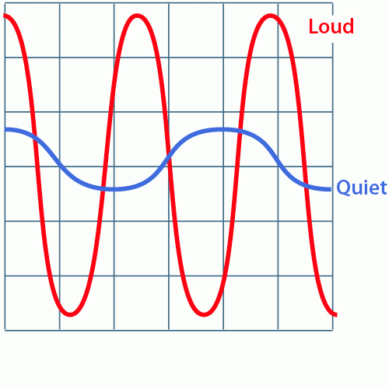

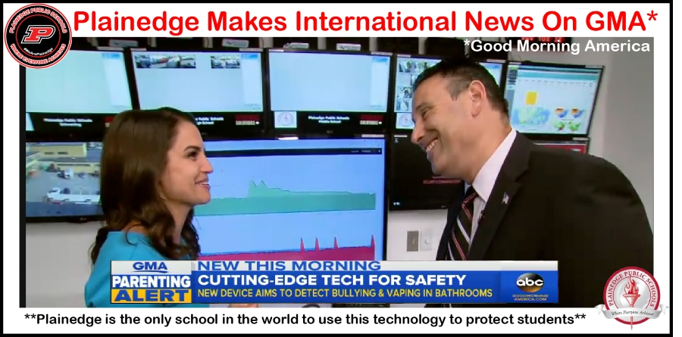

Sensores Ambientais - Bullying / Tiros / Vandalismo

Slide 7
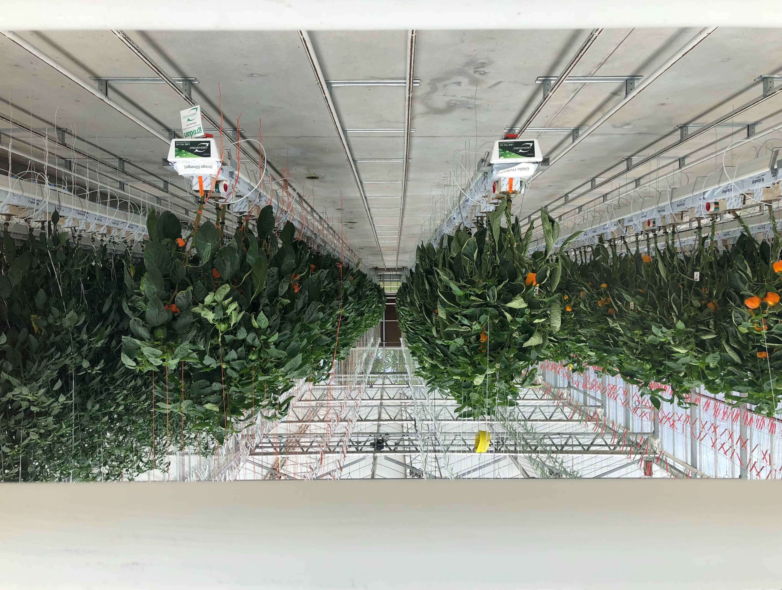

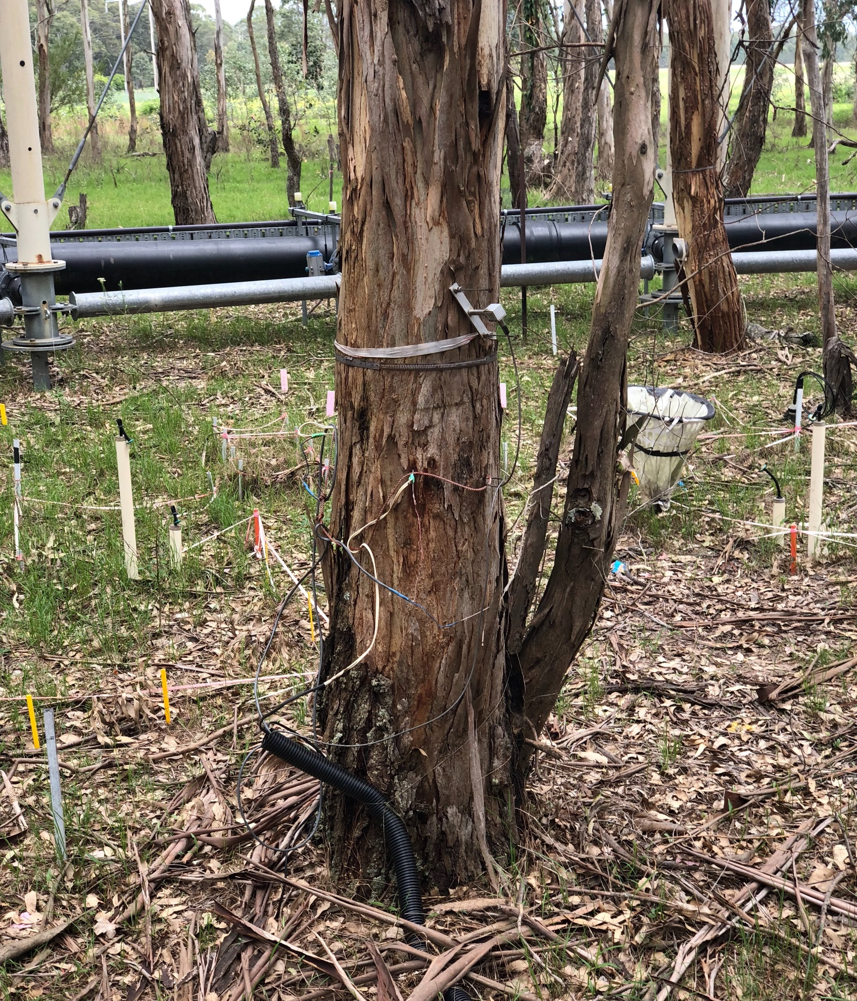

Aprendizado Inteligente: Casos de Uso com IoT
Pesquisa e Desenvolvimento
Estufa
Comparecimento
Copyright 2019 – ARRIS Enterprises, LLC. All rights reserved
7
Copyright 2018 – ARRIS Enterprises, LLC. All rights reserved
Notes:
Here are a few examples from our customers in Australia!
1. IoT for research (Smart Forest) at Western Sydney University – Hawkesbury Campus. CO2 is sprayed and results measured thanks to IoT sensors on the ground, in the branches and inside the trees too. This data is captured and shared (via meshed Ruckus outdoor APs mounted on cranes over each test zone) to share data with researches in other locations
2. STEM learning (Smart Garden) at Western Sydney University – Hawkesbury Campus again, but in their hydroponics lab. IoT sensors measure foliage density, color, fruit or vegetable production, water amount, humidity levels, etc. Control mechanisms allow researchers in remote locations to adjust parameters to optimize plant health and food production. These ‘virtual gardens’ could be used to assign a plant to a classroom who can control them from anywhere!
3. Seamless attendance/truancy management – Trinity College in Melbourne with our partner Skyfii using Ruckus WLAN and SPoT – this use case may help with student retention
a. Is every student in their class during attendance? Did students excused from class return when expected?
b. Students who begin missing classes may be at risk of dropping out, so gives early warning to intervene

Slide 8





Conectividade Convergente da Ruckus
Wireless
Switches
IoT
Rules Engine
Gateway
Dashboard
Copyright 2019 – ARRIS Enterprises, LLC. All rights reserved
Copyright 2019 – ARRIS Enterprises, LLC. All rights reserved
8
Notes:
Traditional APs adopt new IoT and cellular wireless technologies
Connect, power and manage with a common wired and cabled infrastructure
Unified IT and OT that yields new controls and insights across actionable data

